Slide 1
HW 9 SQL
Christopher Krokus

Slide 2
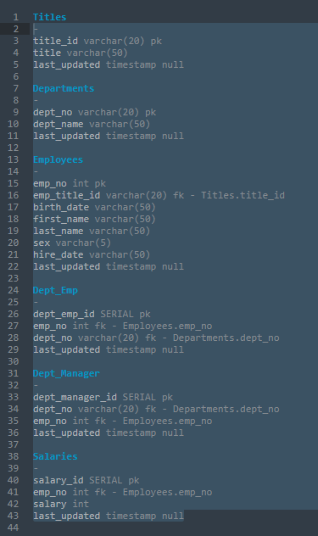
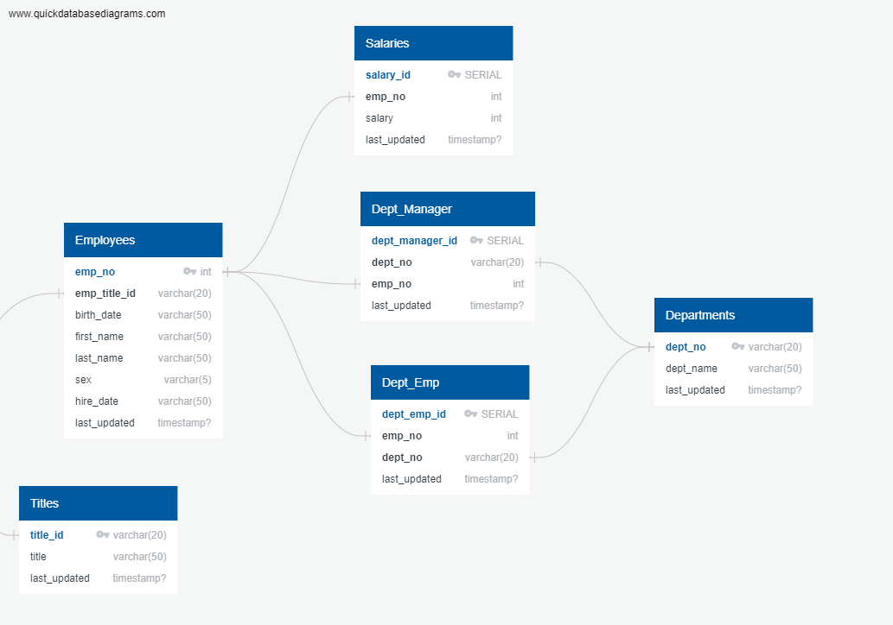
ERD

Slide 3
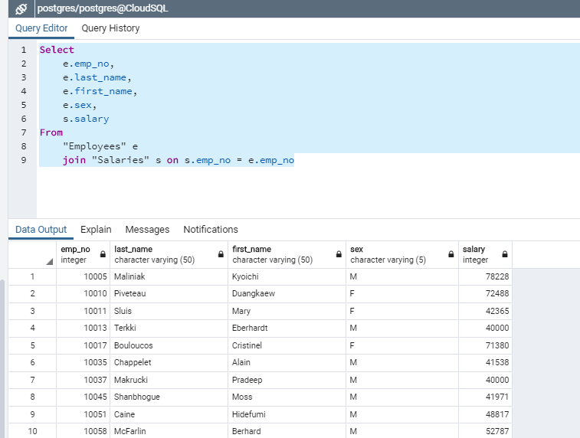
Data Analysis:
1. List the following details of each employee: employee number, last name, first name, sex, and salary.
Employees has emp_no, last_name, first_name, sex
Salaries has emp_no, salary

Slide 4
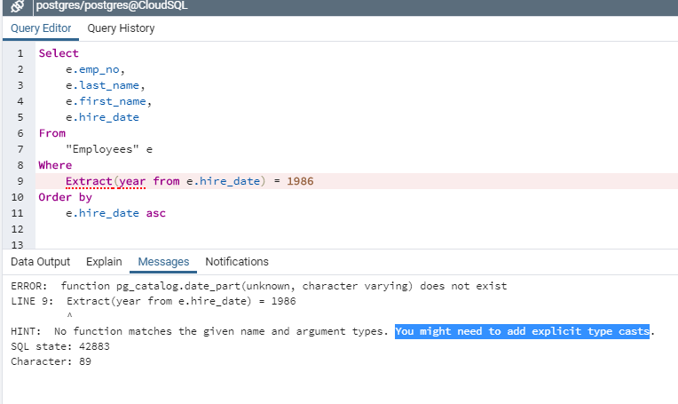
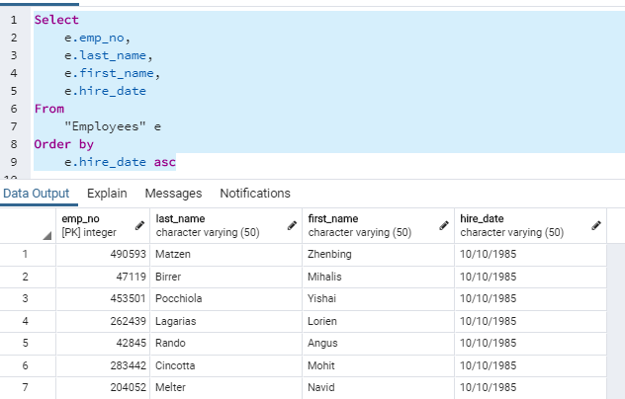
Data Analysis:
2. List first name, last name, and hire date for employees who were hired in 1986.
Employees has last_name, first_name, hire_date
For some reason the Extract(year function was not cooperating

Slide 5
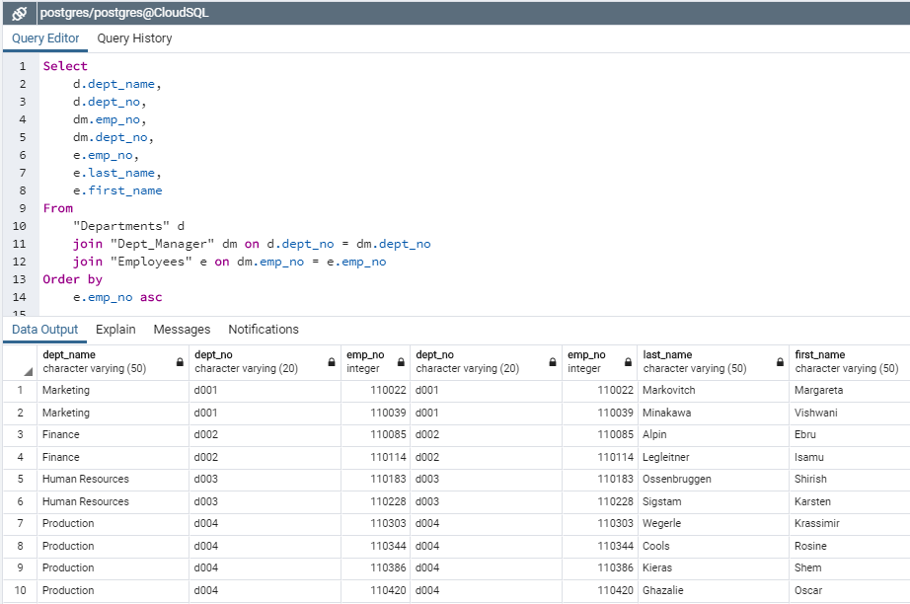
Data Analysis:
3. List the manager of each department with the following information: department number, department name, the manager's employee number, last name, first name.
Departments has dept_name, (dept_no)
Dept_Manager has emp_no*, (dept_no)
Employees has emp_no*, last_name, first_name

Slide 6
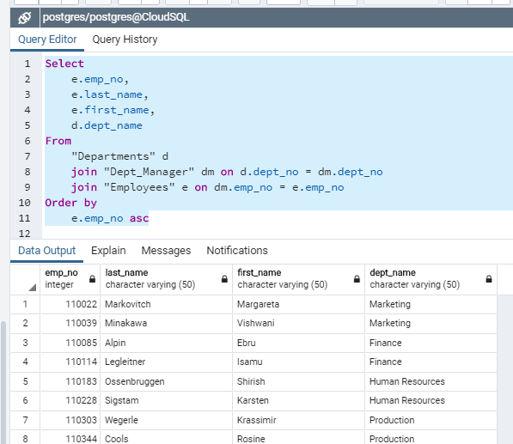
Data Analysis:
4. List the department of each employee with the following information: employee number, last name, first name, and department name.
Employees has emp_no*, last_name, first_name
(Dept_Emp has emp_no*, dept_no**)
Departments has dept_no**, dept_name

Slide 7
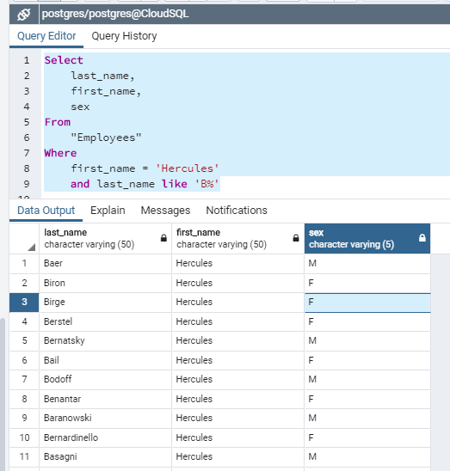
Data Analysis:
5. List first name, last name, and sex for employees whose first name is "Hercules" and last names begin with "B.“
- Employees has first_name, last_name, sex

Slide 8
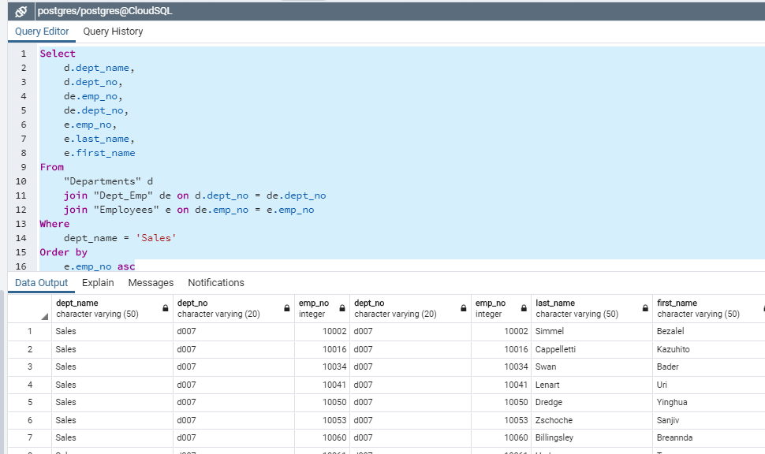
Data Analysis:
6. List all employees in the Sales department, including their employee number, last name, first name, and department name.
Departments has dept_name, dept_no*
Dept_Emp has dept_no*, emp_no**
Employees has emp_no**, last_name, first_name

Slide 9
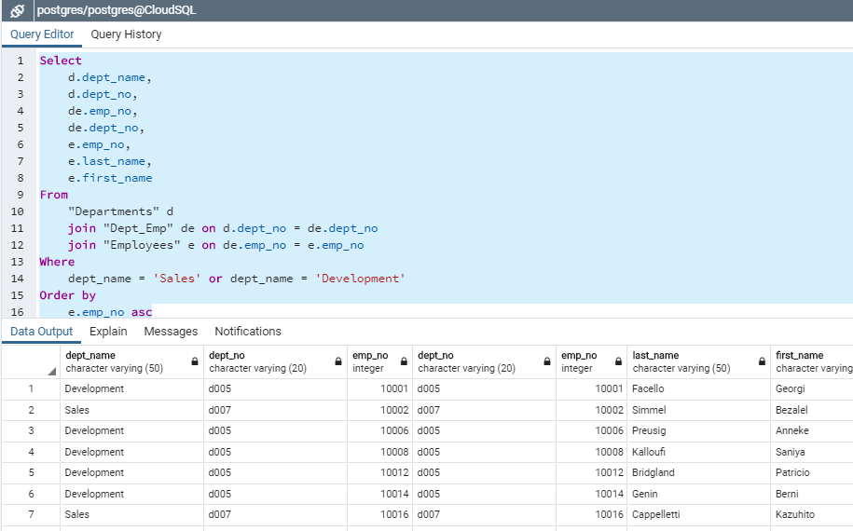
Data Analysis:
7. List all employees in the Sales and Development departments, including their employee number, last name, first name, and department name.

Slide 10
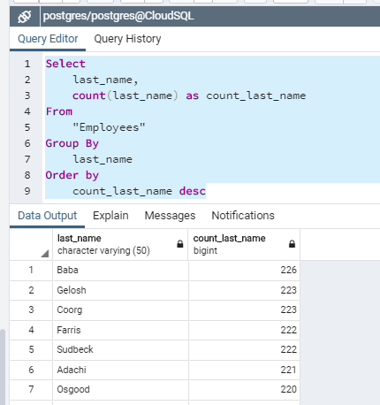
Data Analysis:
8. In descending order, list the frequency count of employee last names, i.e., how many employees share each last name

